Slide 1
The Transition to Office 2007 for CA and CBA
M and K Solutions
Kathleen Johnson

Slide 2
Transition to 2007
The transition from 2003 to 2007 will be interesting
We, as teachers, will:
  Be spending many an evening doing the lessons the night before our students get to that lesson
  Rushing to make tests
  Have to be taking the SAM tests before our students
  Working…

Slide 3
What the teacher needs to do?
All project directions will have to be changed
All supplemental units will have to be changed
  Many of the competencies in CA I, II and III are not covered in a textbook
All objective tests will have to be changed
All SAM tests will have to be redone and scheduled
All student keys will need to be printed out
All Office 2007 changes will need to be addressed
All classes will need to mapped to the frameworks, AGAIN!
Ugh!

Slide 4
What to do about Ugh?
Work, work, work, work
Worry about how you will have time to manage clubs, your classes, and the other daily distractions and duties you have?
I don’t like working at night...

Slide 5
Our Answer
CA Web 2007

Slide 6
CA Web 2007
CA Web 2007 is a web-based delivery system
This allows your students to walk in the door and be a click away from all the materials for
CA I, II, and III and CBA
Allows teachers a way to manage CA I, II, and III students in the same classroom, where this is necessary
Works in large, mid-sized and small schools

Slide 7
Beginning of a Normal Classroom
Mrs. Johnson, I need the syllabus for Word Lesson 2? Excel 2? PowerPoint 1?
What did we do yesterday?
Did I pass that test yesterday?
The sub didn’t have what I needed yesterday, so I just played games.
I’m not sure what to do next?
Do you have a sample project I can see?
And more…
To us, this is wasted time. Students just sit there waiting for you.

Slide 8
What I love about this program!
No more wasting time at the beginning of the period waiting for you to hunt papers
No more lesson plans for the substitute and no more excuses when a substitute is in the classroom
No more questions about makeup work
Students just continue where they left off

Slide 9
What I love about this program
Students are moving through the classes faster
Focused students because they know exactly what to do, when to do it, etc.
Fewer discipline problems
Advanced students can move quickly through lessons
Rigor, Relevance and Relationships

Slide 10
What I love about this program!
More time to spend coaching students
More time to spend visiting and bonding with students
More time to spend managing the classroom dynamics

Slide 11
What I love about this program!
More time to mentor as you teach
More time for “just in time” teaching
More time for ALL the other things I have to do

Slide 12
What I love about this program!
More time to just breathe…
More time…
The thought of NOT having this curriculum caused many of us to hyperventilate

Slide 13
CBA and CA
Developed for CA, and now, CBA
We realized that CA and CBA cover many of the same competencies
This program works for teacher-led and self-paced
Mastery is a requirement of CA, but our program can accommodate the CBA model

Slide 14
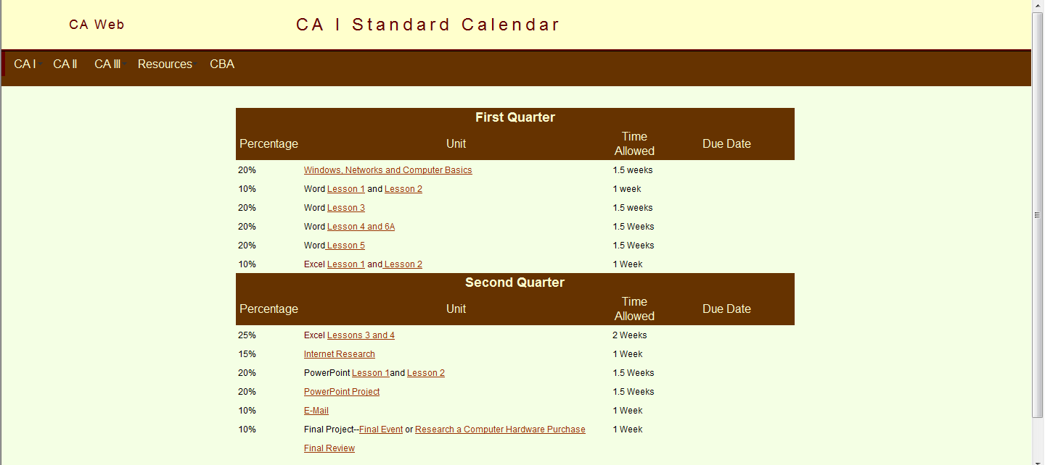
Calendars
Detailed calendars for every class with time-frames and due dates for you to edit

Slide 15
Lesson Pages
Color coding for each section in the book. Excel, Word, Access, PowerPoint Awesome!!!!
Detailed instructions about what to do, page numbers, and what to turn in and when
All files hyperlinked to the appropriate web pages
Tells when to test
PowerPoints for every lesson which are correlated to the frameworks and tests
Literacy strategies focused on terminology acquisition
Ready to print

Slide 16
Supplemental Units
Several of the competencies in CA I, II and III are NOT in a textbook
These are included and mapped to the frameworks
These include many screen shots, easy-to-follow directions and annotated student keys
PowerPoints at the end of each lesson include terminology from the supplemental units
Ready to print

Slide 17
Projects
Many great projects for students with detailed directions, screen-shots, etc.
Includes samples of good projects so your students have a clear picture of your expectations
Detailed rubrics for students and teachers
Presentation skills are included
Designed for printing if students need this

Slide 18
Student Reviews & Tests
PowerPoints for every lesson and supplemental unit
CA I—2-column notes
  Students print out and complete these
SAM Review for students
Tells students when to test

Slide 19
Finals & Competency Tests
Final Reviews for CA I, II and III and CBA (will need to be edited by the instructor)
Test Banks in ExamView for CA I
  Window and Word 1
  Window and Word 2
  Excel, PowerPoint and Internet
  These will need to be published for students

Slide 20
Teacher Web
A companion, complimentary Teacher Web is also provided
Everything you need is done!

Slide 21
For Each Lesson
Detailed, linked lists of student keys for you to print
ExamView multiple choice tests that cover all skills in that unit from the state frameworks
Companion ExamView multiple choice tests for resource students with fewer choices and/or fewer questions
Traditional production tests with keys and rubrics
Instructions for completing SAMS tests for each unit

Slide 22
Finals and Competency Tests
Semester tests are provided
Practice Competency Test ExamView banks are provided for you to use in preparing your students for the CA I Competency test
  All you have to do is publish these and let students take them over and over for practice

Slide 23
Resources
Mapping for CA I, II, and III and CBA are already done for you
Instructions on SAM tests
Rules for Challenging
Grading and Testing Suggestions
And more
Show Teacher Web

Slide 24
Customizable
It is completely customizable using any web page software
  You can use it as it is, only changing the due dates
  You make any changes you want
  You can add projects you like instead of ours

Slide 25

Can Be Used For Training
This is a great training tool to teach your faculty Office 2007
  They would need access to a book

Slide 26
Affordable
One price includes one high school and its feeder schools
It is a one time cost--not a subscription that has to be renewed each year
  The only time you will need to make a new purchase is for a different software version

Slide 27
Easily Installed
You don't have to have a tech team to run it
You can run it out of your own classroom or department
  All you need is a workstation in your department that can be dedicated to running your web
  Instructions and software are included
  It's easy
  If you prefer, your tech department can install it on their IIS server

Slide 28
Requirements
This is an Intranet
You may not give public Internet access to it
You must provide a copy of the textbook, Introductory Office 2007 by Pasewark and Pasewark (Cengage) , for each student
You must have the companion Teacher Resources disk
You must use our order form with the signed license contract on it (You can just include it with a school PO)
You must have Office 2007 installed on each workstation

Slide 29
Questions, Comments
?

